Slide 1
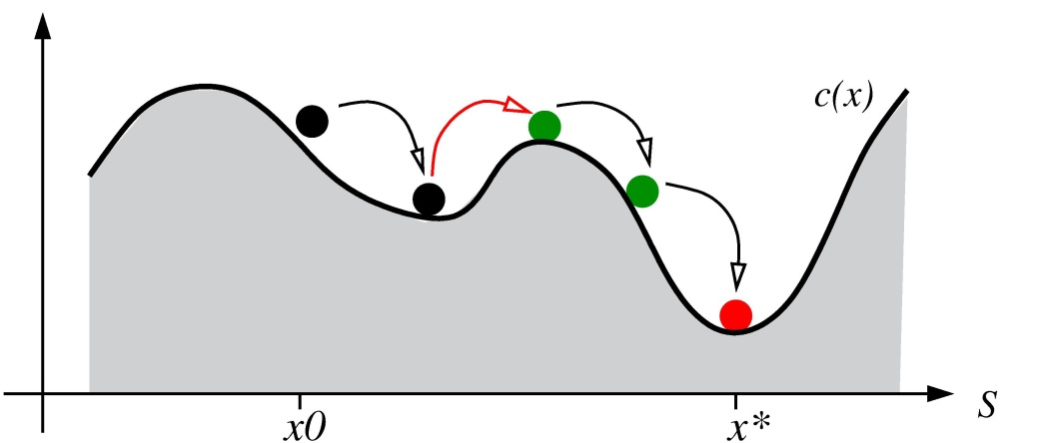
CS182 Final Project (Title Here)
Jason Cui (jasoncui@college.harvard.edu) | Annie Hwang (annhwang@college.harvard.edu)
CS182
Fall 2016
Introduction & Problem Statement
The idea for the project came to be when we realized it was very difficult to keep track and be on top of your nutrition. Leading a healthy diet and lifestyle can be incredibly difficult, and with busy schedules and not enough time to cook it can be easy to overlook nutrition.
There exist software solutions out there designed to help make tracking nutrition easier. The best example is MyFitnessPal, which is a mobile phone application that allows users to input their daily intake of foods in order to keep track of calories and macronutrients. There also exist services like Yelp that allow users to discover restaurants and places to eat. The problem with these sorts of services, however, is that they are very low level. In the end, individuals still have to make their own decisions about where they eat and what they choose to eat.
Project Abstract
Abstract goes in here
Describe the data, experiments etc
Conclusions
blah blah blah
Results
blah blah blah
Figure 2. And all about Figure 2.
Citations and Links
Protopapas, P. P., and friends. 2013. How we taught AM207 and lived to tell the tale. IACS Journal 1:1–3.
The students of AM207. 2013. Everything we know, we learned in AM207. IACS Journal 1:3–5.
John A. Paulson School of Engineering and Applied Sciences

